Slide 1


USDA crop data & Price Forecasting
Kali Williams, Erin Nazetta, Joel Aponte and Onuwa Nwosu

Slide 2
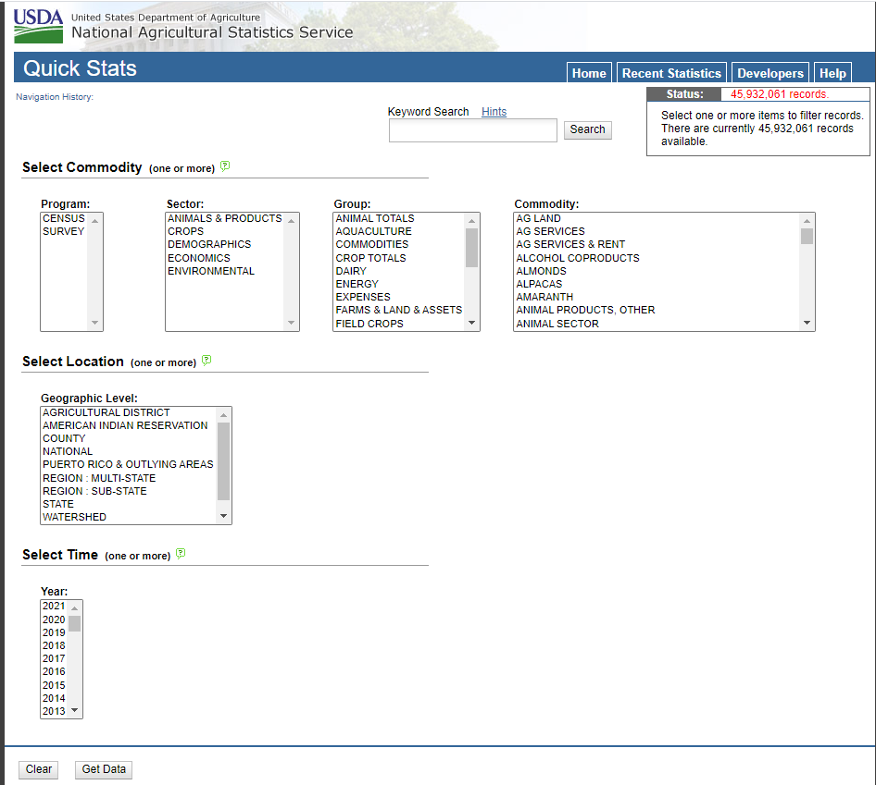
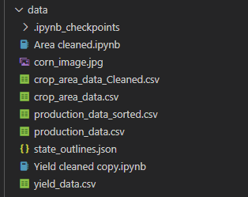
Visualizing USDA for crops - Data
Downloaded data for crops
Used pandas to clean
Used SQL and Flask

Slide 3
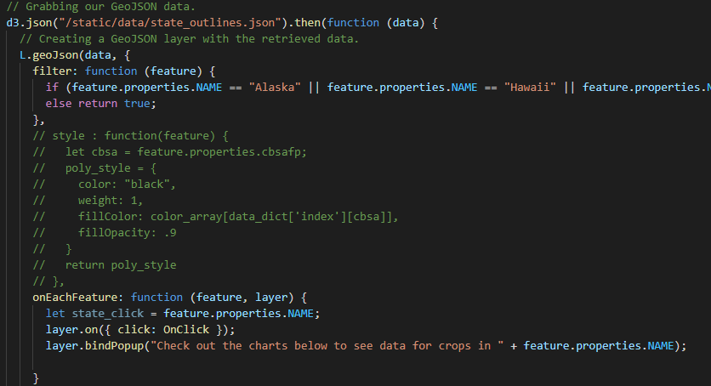
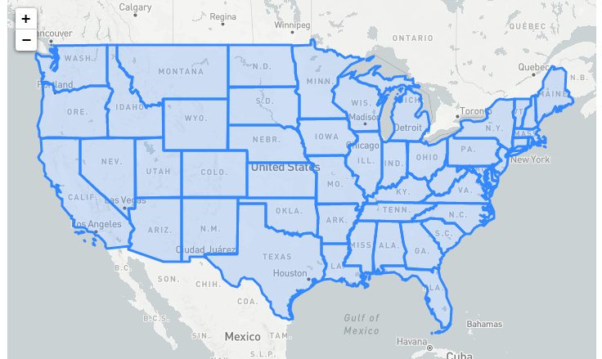
Creating the map
Adding a map
Creating state borders – using GeoJSON
Removed Alaska, Hawaii, Puerto Rico
Created feature click to output state name

Slide 4
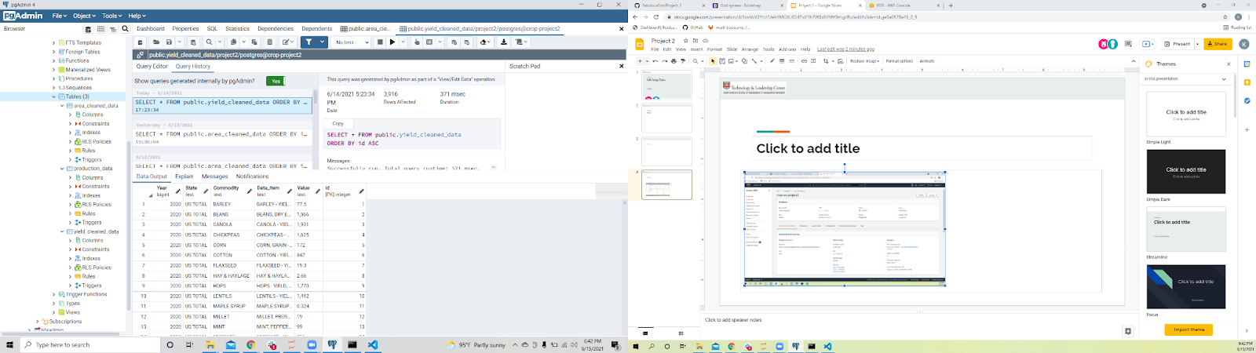
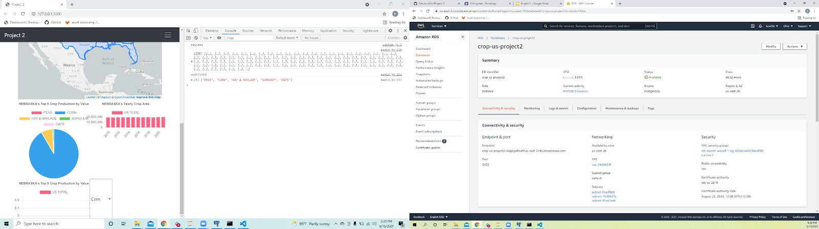
Database Connection
Cleaned Data with Jupyter Notebooks and created a postgres database with AWS connection

Slide 5
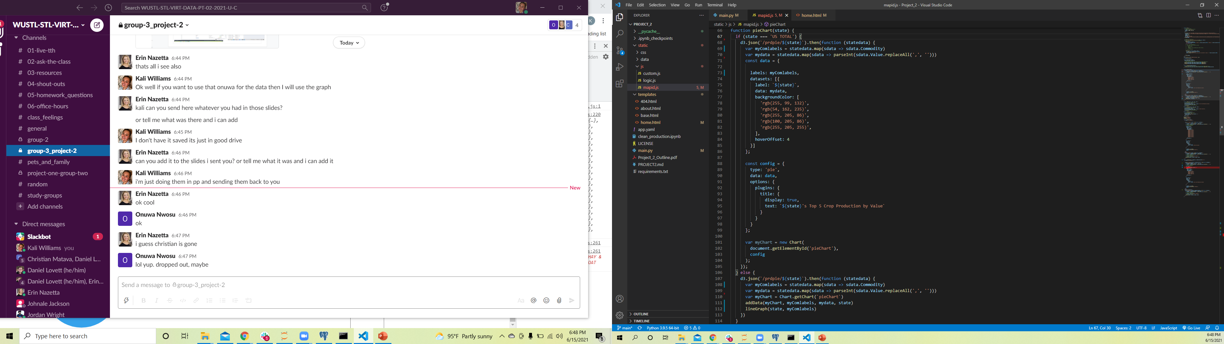
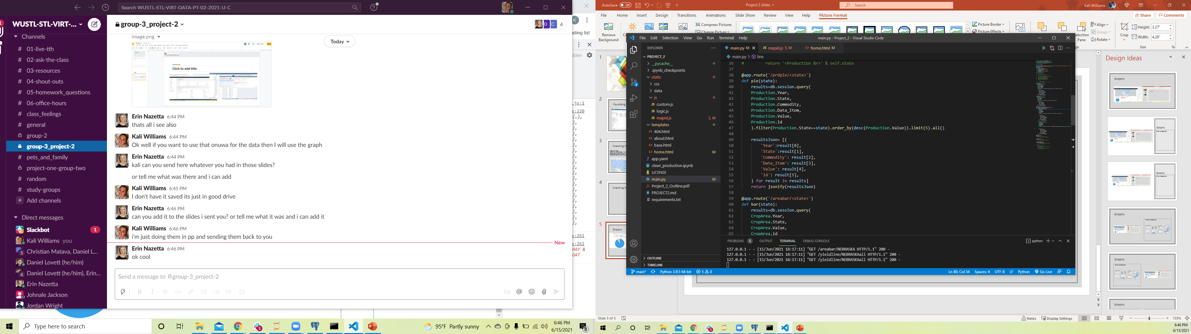
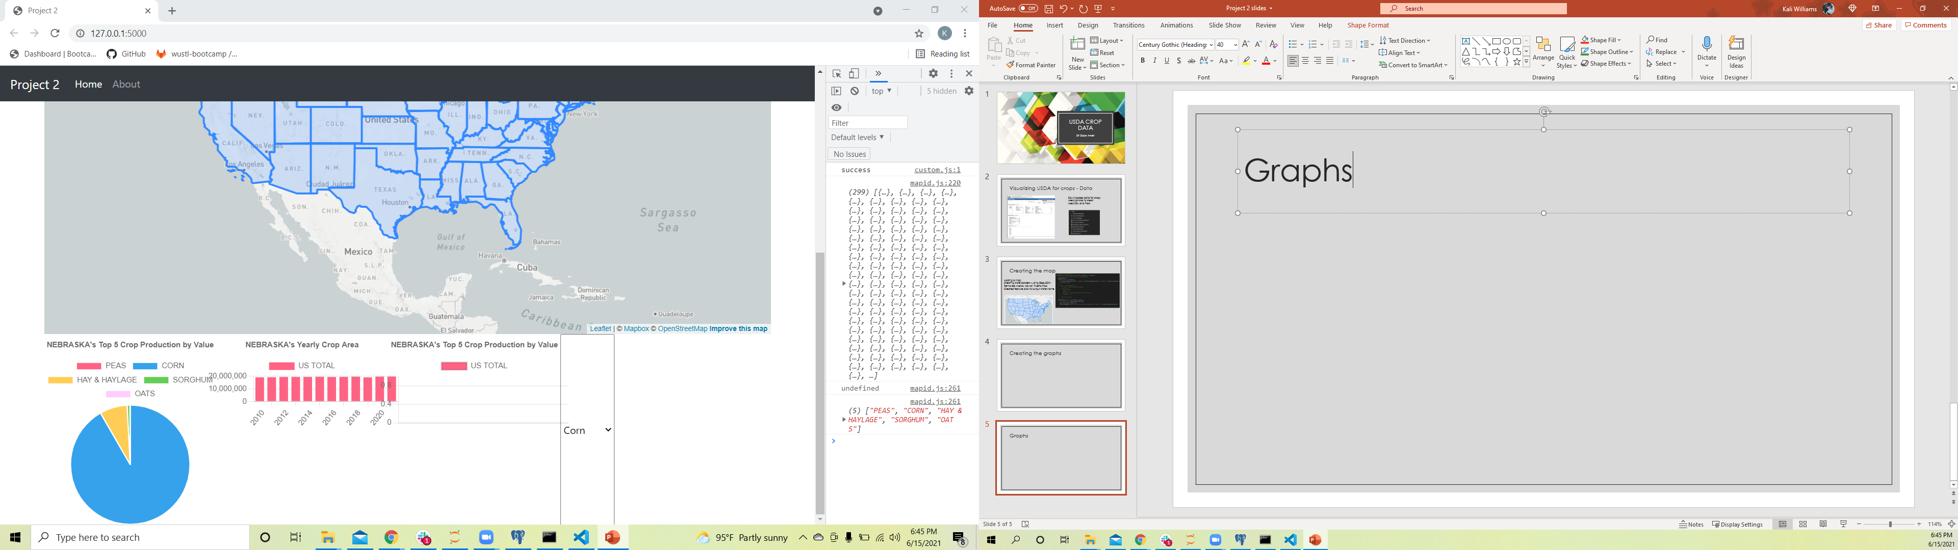
Graphs
Once you click on a particular state, the pie graph, bar chart and line graph will pull in the specific Production, Area and Yield data set, custom to each state.
Chart.js was used in creation of the graphs.

Slide 6
Final Project

Slide 7
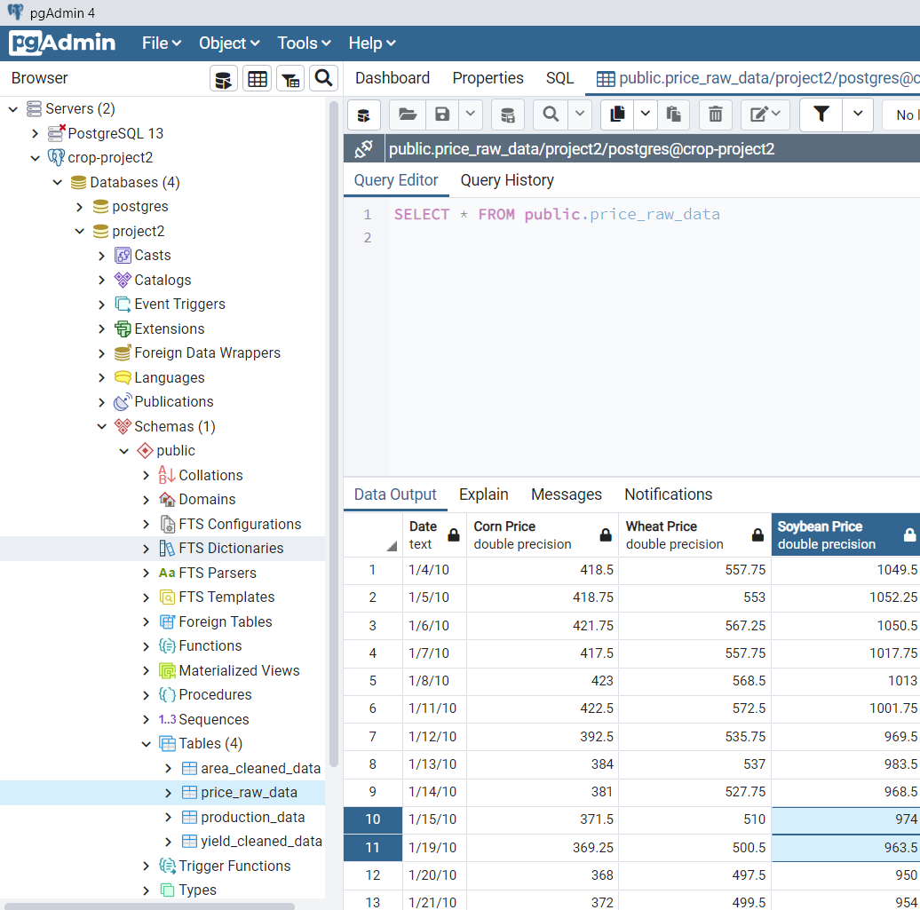
Crop Price Predictions
Continue building our Crop Data
Use Machine Learning to predict future crop prices
Top 5 US Crops
Corn
Cotton
Soybean
Wheat
Hay
Hay is mostly used for cattle feed
Looked at Cattle Prices

Slide 8
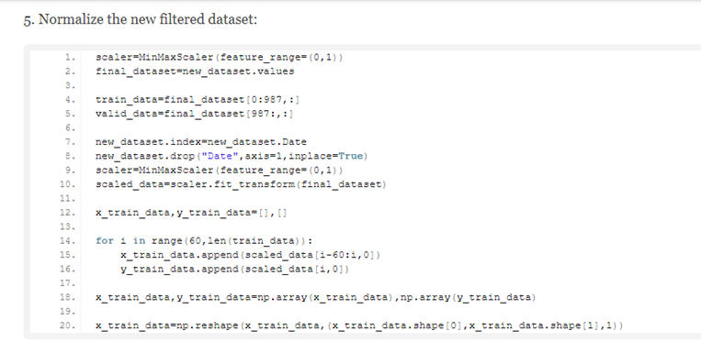
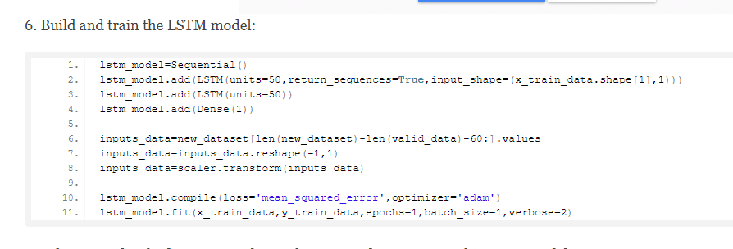
Long Short-Term Memory (LSTM) Neural Network
https://data-flair.training/blogs/stock-price-prediction-machine-learning-project-in-python/
Multiple issues with package installations
Date Column being used to predict prices
Actual date itself does not affect prices
Continued with more Data Analysis to find correct data for predictions

Slide 9

Data Analysis
.shift() to create price lag columns and remove null numbers
Lagged columns look at the price from 1, 5, 10, and 20 days before.
Corn is used for cattle feed
Look to see if the previous corn price influenced the price of cattle
Looked for Seasonality
Daily (weekday)
Monthly

Slide 10
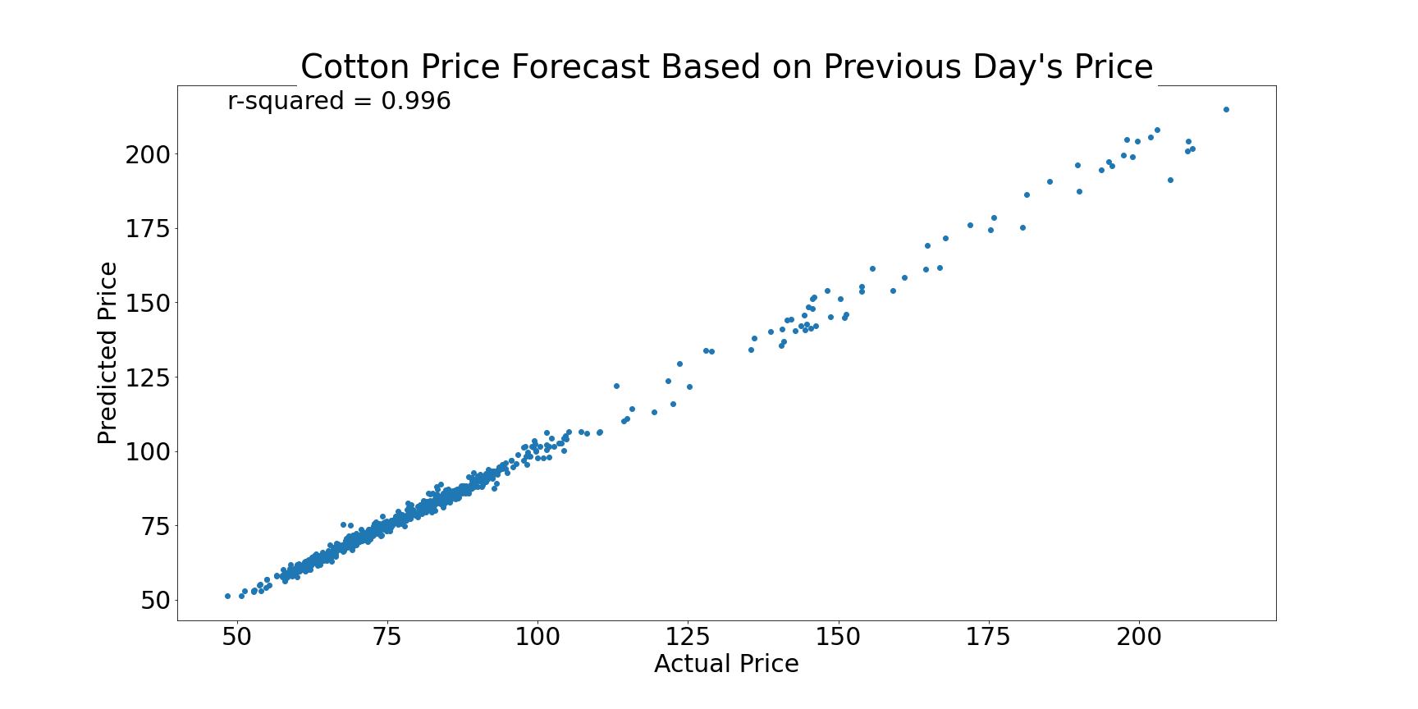
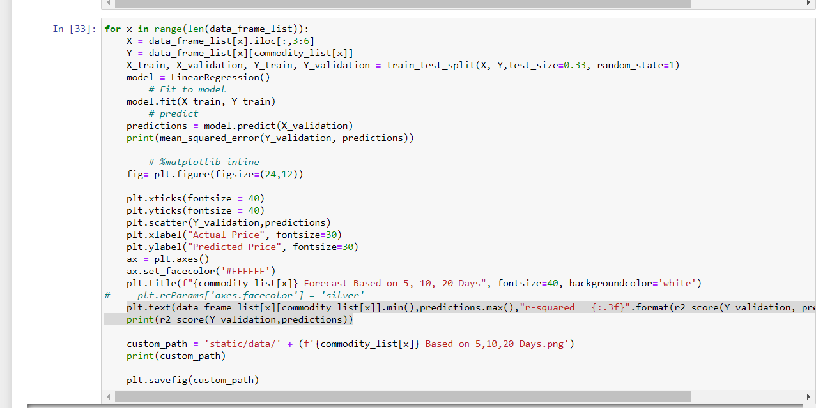
Linear Regression

Slide 11
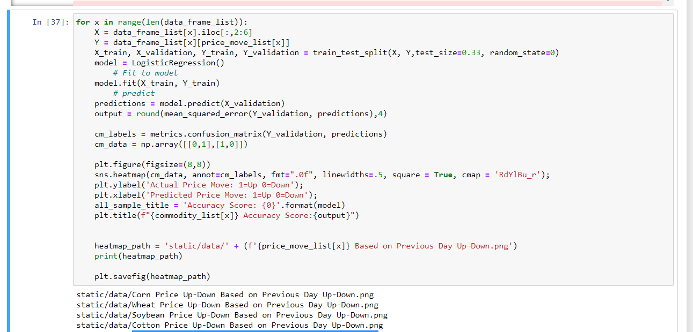
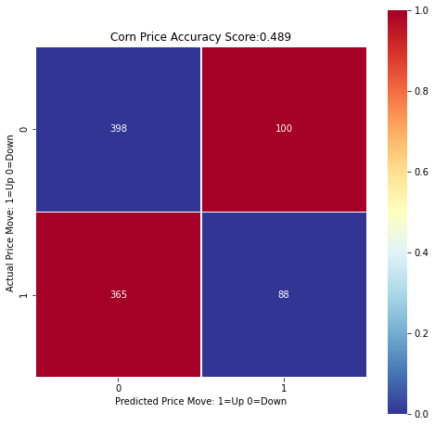
Logistic Regression

Slide 12
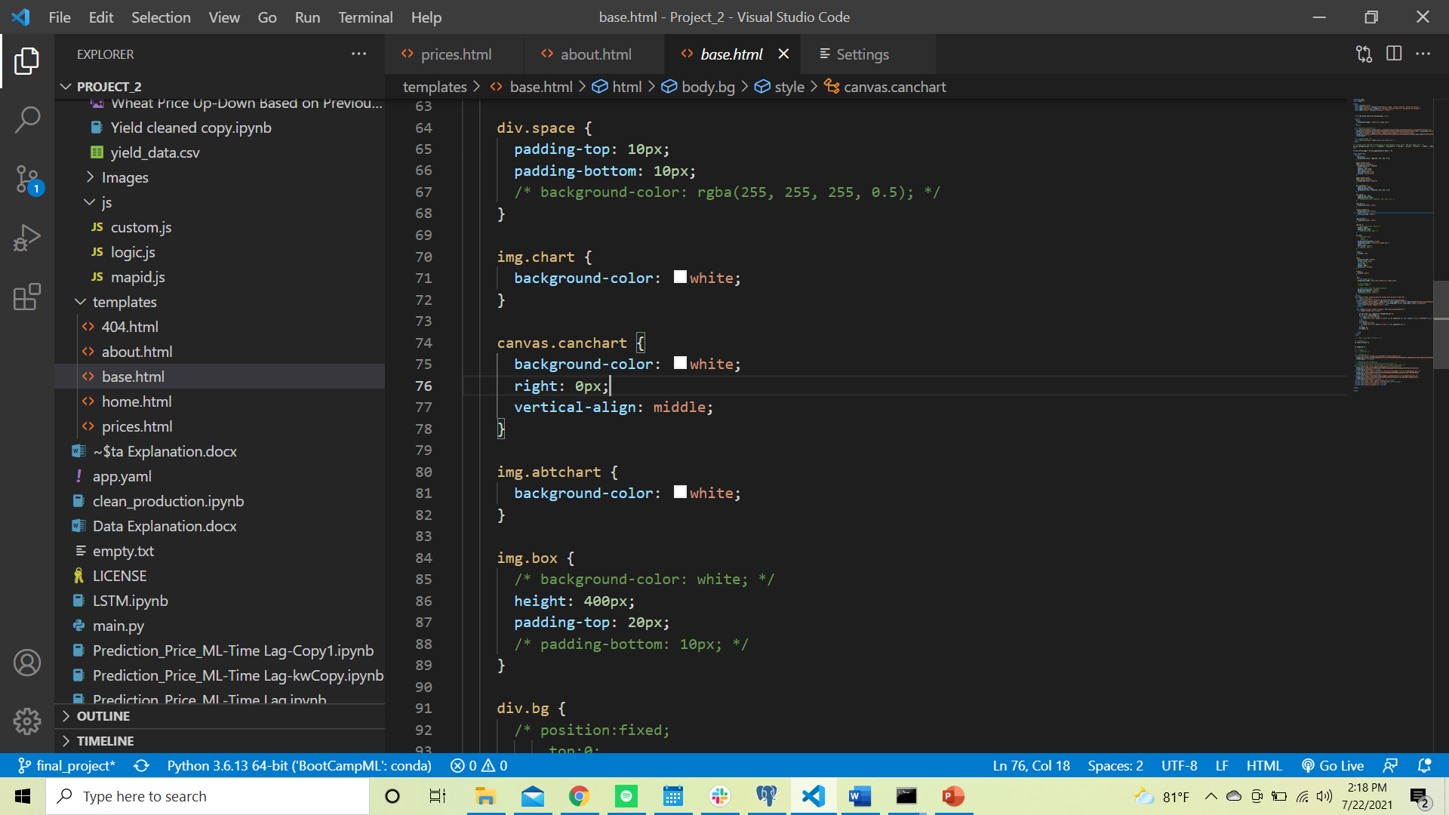
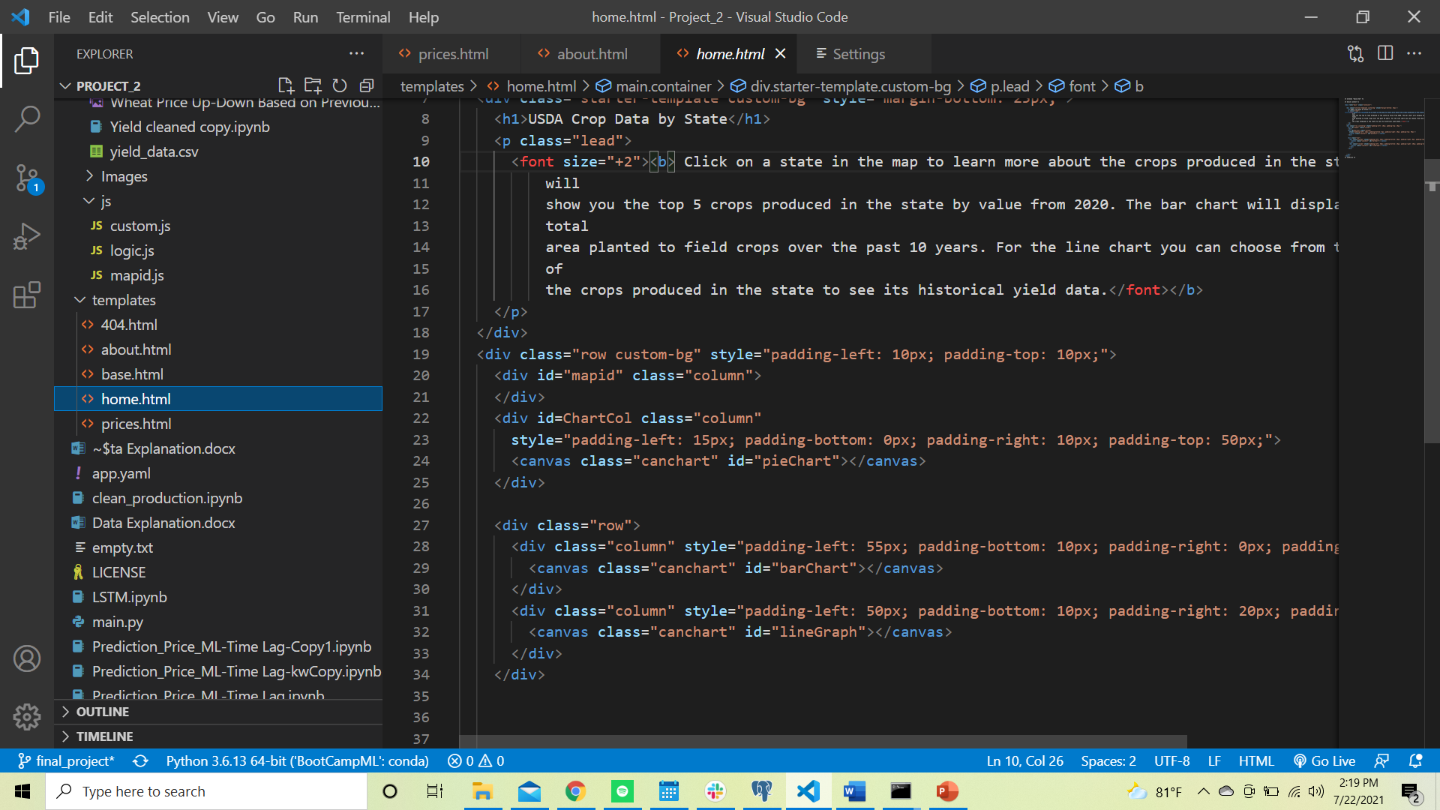
JS and HMTL Formatting

Slide 13
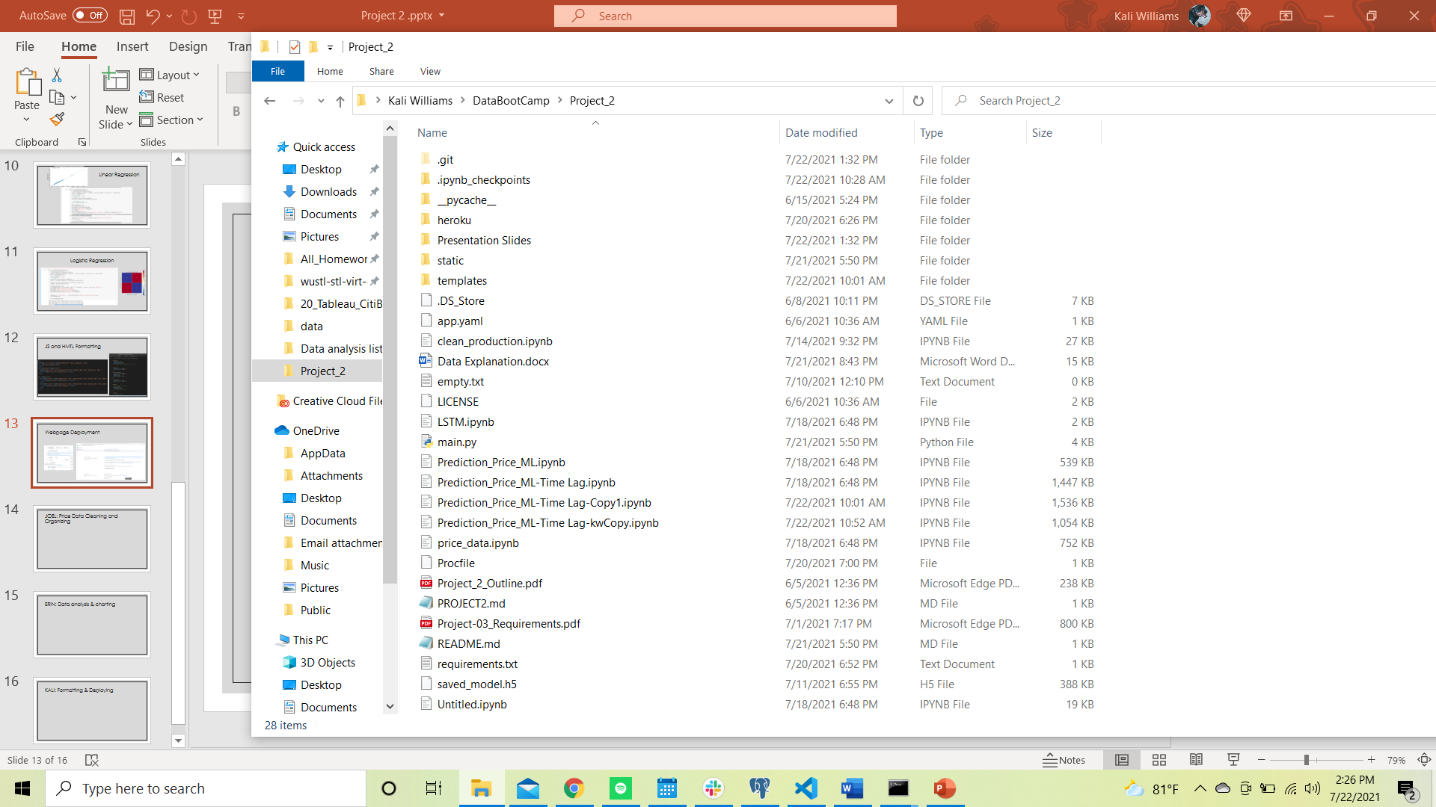
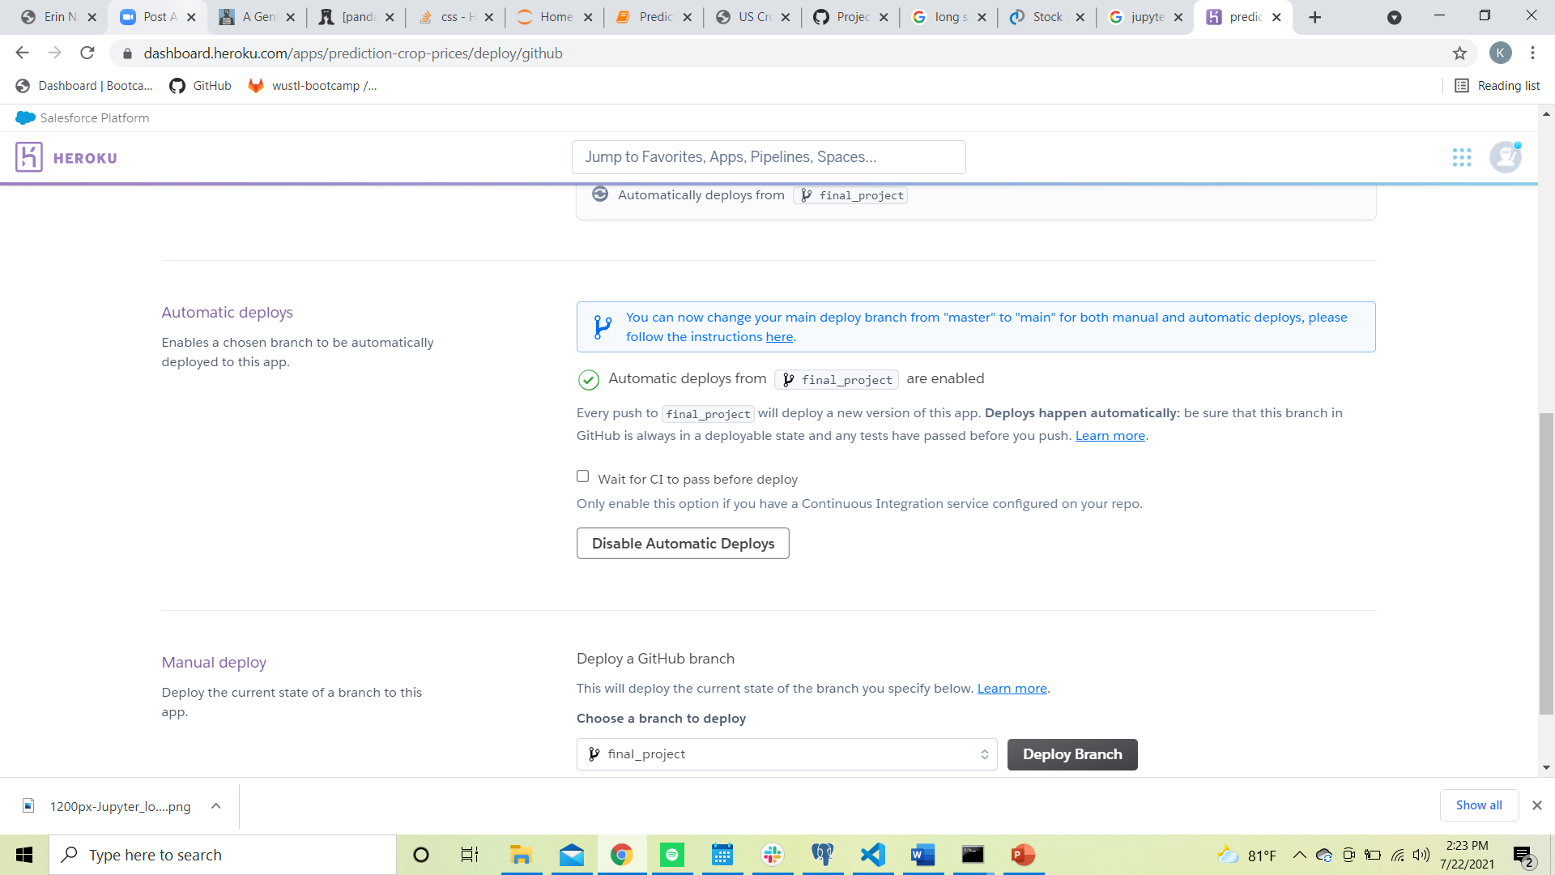
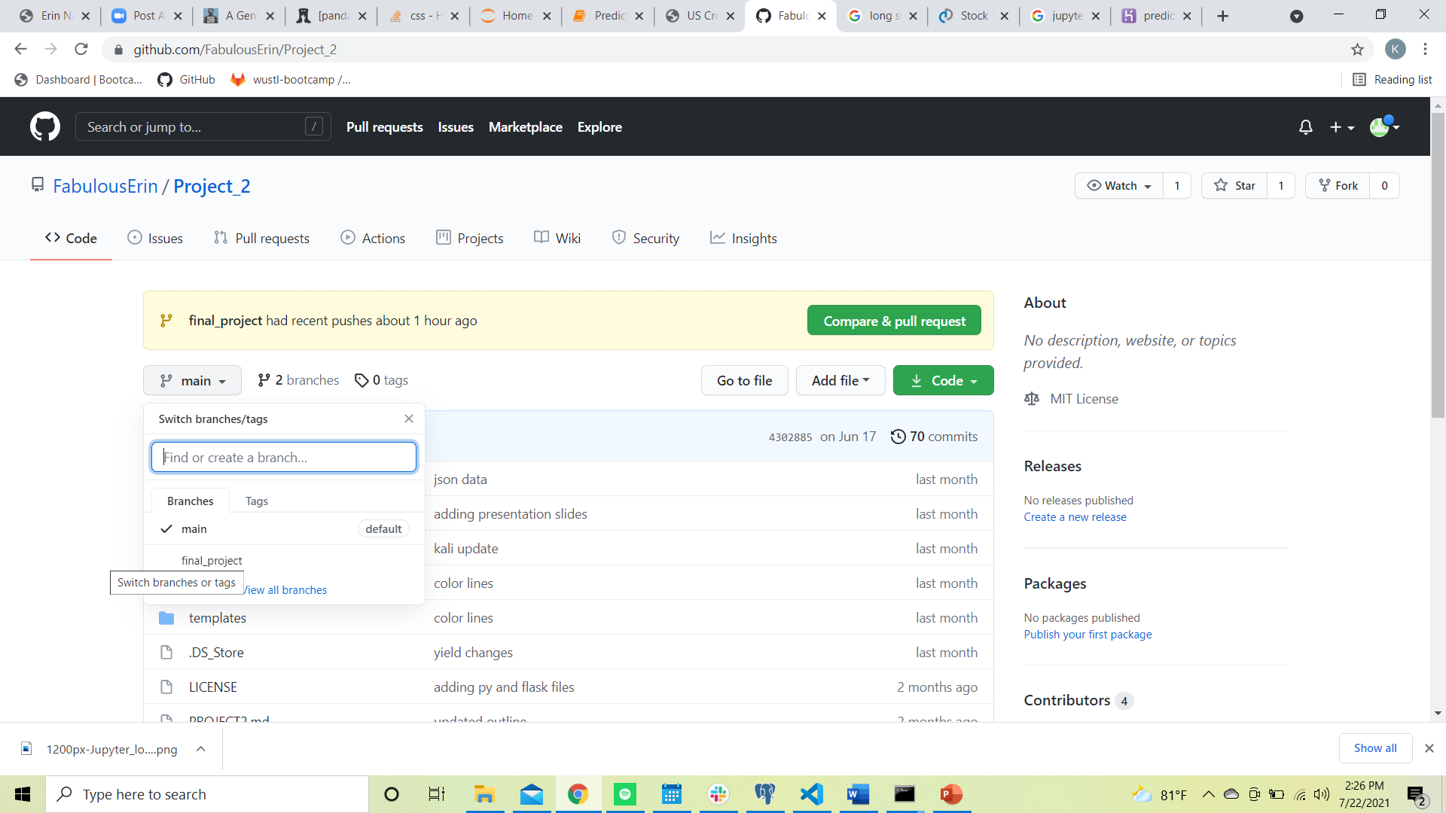
Webpage Deployment
https://prediction-crop-prices.herokuapp.com/prices

Slide 14
JOEL: Price Data Cleaning and Organizing

Slide 15
ERIN: Data analysis & charting

Slide 16
KALI: Formatting & Deploying

